Slide 1

Department of Information Technology
Project Title :- Movie & Song Recommender System Based on Emotion Detection using ML
Group Number: 22IT701
Group members :- 1. Name:- Shruti Gupta (1900970130116)
2. Name:- Shivam Prajapati (1900970130111)
3. Name:- Rahul Tewari (1900970130089)
Project Guide :- Name:- Dr. Sanjeev Kumar Singh
Designation :- Professor and HOD

Slide 2
Table of Contents
Team Work
Design Document
System Architecture
Pipeline for Emotion Detection
Flow Chart- Recommender System
Test Cases and Dataset
Implementation
Emotion Detection
Movie and Song Recommendation System
Modules and System Integration
Technology Used
Description of Concept
Emotion Part (Detection + Recommendation)
Recommendation Part (Movie and Song Recommendation)

Slide 3
Table of Contents [Continued…]
Result
Conclusion
Future Scope

Slide 4
1. Team Work
Shruti Gupta
(Team Leader)
Exploratory Data Analysis, Dataset preparation & Documentation
Shivam Prajapati
Research, code implementation & Documentation
Rahul Tewari
Coding, Feature Engineering & Model Buiding

Slide 5
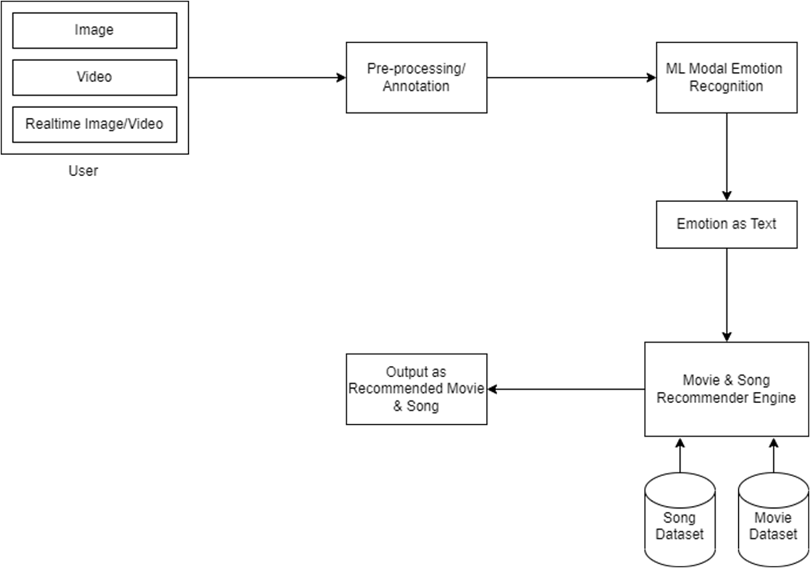
2.1 Design Document (System Architecture)

Slide 6
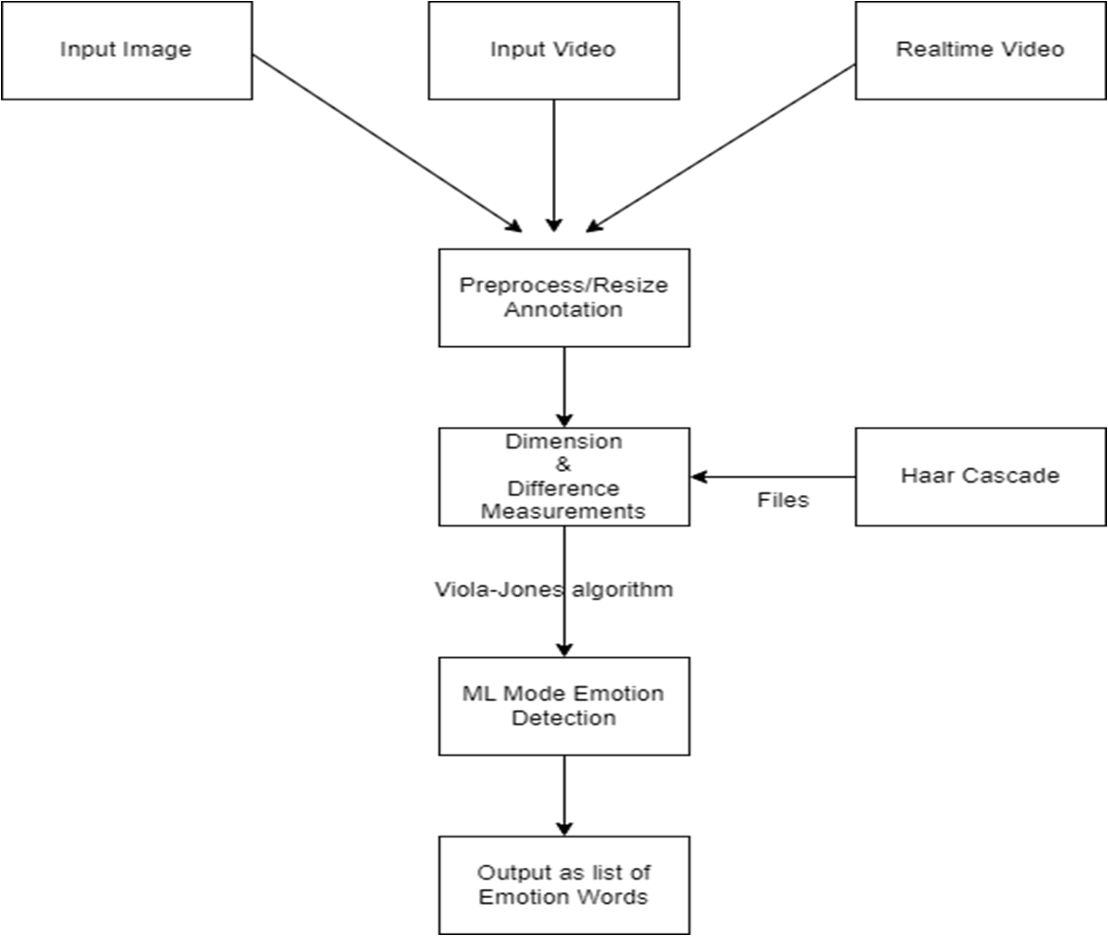
2.2 Design Document (Pipeline for Emotion Detection)

Slide 7
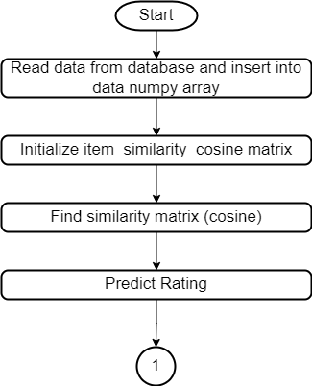
2.3 Design Document (Flow Chart- Recommender System)

Slide 8
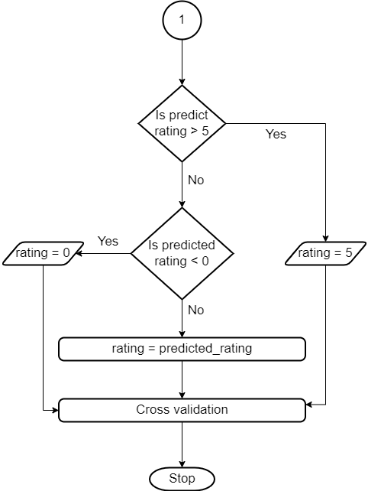
2.3 Design Document (Flow Chart- Recommender System) [Continued…]

Slide 9
3. Test cases and dataset
We can accept input data in any format( image, video or real time data) from user and provide textual output as movies and song based on their current facial expression/emotion.
Database and Test cases
Emotion detection dataset
Recommender system dataset
Real time data
Image Data
Video Data
Netflix Movie Dataset
Song Dataset

Slide 10
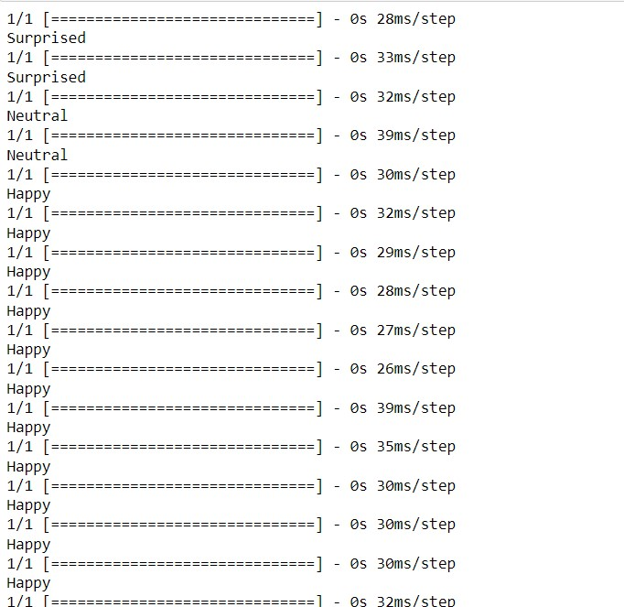

4.1 Implementation of Emotion Detection

Slide 11
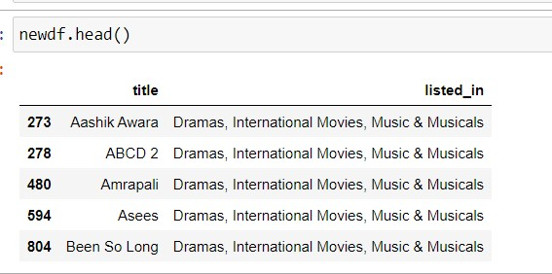
4.2 Implementation of Movie and Song Recommendation System

Slide 12
5. Modules and System Integration
To integrate the emotion detection module with the movies and song recommender system, we could modify the recommendation algorithm to take into account the user's emotional state.
To filter the recommended movies or songs based on their emotional content or use a weighted cosine similarity that gives more weight to items that match the user's emotional state.
To use a hybrid recommendation approach that combines both content-based and collaborative filtering techniques to recommend items based on both the user's preferences and emotional state.
Emotion Detection
Recommender System
Movie and Song Recommender System based on Emotion Detection
Emotion detection is based on pretrained Haarcascade algorithms and john- viola algorithms.
Recommender System is based on Cosine Similarity on Genre and Description variables.

Slide 13



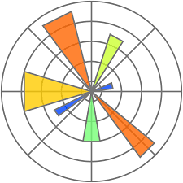



6. Technology Used
Python Pandas Seaborn Matplotlib
SKLearn Tensorflow OpenCV

Slide 14
7. Description Of Project
Emotion Detection
Emotion Part
Emotion Recognition
Movie & Song Recommender System Based on Emotion Detection
Movie Recommender System
Recommender Part
Song Recommender System

Slide 15
7.1 Emotion Part (Detection + Recognition)
This project includes Emotion detection based on Haar cascades algorithm and emotion recognition and classification based on SVM(Support Vector Machine).
The general steps for emotion detection with Haar cascades includes:
Load the pre-trained Haar cascade for face detection
Capture the video frames or images that need to be analyzed
Use the Haar cascade to detect faces in the frames or images
Extract the facial features from the detected faces
Use a machine learning algorithm, such as an SVM, to classify the facial features into different emotions (e.g. happy, sad, angry, etc.)
Display the emotion detected on the screen

Slide 16
7.2 Recommedation Part (Movie + Song Recommendation)
Cosine similarity is used in recommendation systems to find similarities between items, such as movies or songs.
The general steps to recommend movies or songs are:
Build or extract a dataset of movies or songs with relevant features. For example, for movies, the features could be genres, director, actors, and plot keywords. For songs, the features could be genre, artist, tempo, and lyrics.
Represent the features of each item as a vector.
Calculate the cosine similarity between each pair of movies or songs using their feature vectors. Cosine similarity is a measure of the similarity between two vectors and ranges from -1 to 1, where 1 indicates identical vectors and -1 indicates completely opposite vectors.
For a given movie or song, find the items with the highest cosine similarity values. These are the items that are most similar to the given item and can be recommended to the user.
In this project, we recommend movies and songs based on genre or description column.

Slide 17

8 Result
Detected Emotion
Emotion Detection
Sad
Emotion Recognition
Recommendation
Recommendation Engine
List of Comedy Movies
Final Result

Slide 18
9 Conclusion
Emotion-based recommendation System can provide customized recommendations based on user’s behaviour , improve user engagement ,leading to increased revenue for streaming platforms.
We utilized various techniques including cosine similarity with collaborative filtering, emotion detection using Haar-Cascade algorithm, CNN model-based content filtering, matrix factorization and Supervised learning.
Challenges such as accurate emotion detection algorithms, user privacy concerns and potential algorithm bias need to be addressed for the proper accuracy and success of these systems.
With further development and improvement, emotion detection-based movie and song recommender systems could become a key differentiator for streaming platforms in the highly competitive entertainment industry.

Slide 19
10 Future Scope
Developing a web application for this emotion-based recommender system has the potential to significantly enhance the user experience and increase engagement, as it would provide a convenient platform for users to receive personalized recommendations based on their current emotional state.
Emotion detection technology can be used to suggest products or services that match the user's emotional state, creating new revenue streams by contracting with advertisers.
It can integrate with virtual and augmented reality for personalized recommendations that improve the user experience.
These systems can help improve mental health by suggesting movies and songs that match a user's emotional state, such as suggesting tranquilizing movies and songs to help calm someone down if they are feeling anxious.

Slide 20

Thank
You

